Slide 1
ACCESS MODIFIERS IN JAVA

Slide 2
User define class (MyClass)
public class abc {
public static void main(String args[]) {
MyClass x=new MyClass();
x.myMethod();
}
}
class MyClass {
public void myMethod() {
System.out.println("A method in MyClass.");
}
}

Slide 3
Introduction
The access modifiers in java specifies accessibility (scope) of a data member, method, constructor or class.
There are 4 types of java access modifiers:
private
default
protected
public

Slide 4
Private Access Modifier
The private access modifier is accessible only within class.
Example:
class MyClass {
private void myMethod() {
System.out.println("A method in MyClass.");
}
} public class abc {
public static void main(String args[]) {
MyClass x=new MyClass();
x.myMethod(); // error: private access in MyClass
}
}

Slide 5
Private Constructor
If you make any class constructor private, you cannot create the instance of that class from outside the class.
Example:
class MyClass {
private void MyClass() // Private constructor
{ System.out.println("A method in MyClass."); }
}
public class abc {
public static void main(String args[]) {
MyClass x=new MyClass(); // Compiler error
}
}

Slide 6
Nested Class
Note: A class cannot be private or protected except nested class.
class Outer {
private class InnerPrivate { }
protected class InnerProtected { }
}
private class InnerPrivate { }
protected class InnerProtected{ }
//These will throw a compile-time error.
Top-level classes (classes not nested inside another) must be either:
public, so they’re accessible from anywhere, or
default (no modifier), meaning they’re accessible only within the same package

Slide 7
class MyClass {
// Non-static inner class; it can be public | protected
class Inner {
void display() {System.out.println("inner non stat");}
}
}
public class Test {
public static void main(String args[]) {
// Using inner class
MyClass outer = new MyClass();
MyClass.Inner innerObj = outer.new Inner();
innerObj.display();
}
}

Slide 8
Package in JAVA
A package is like a folder for your Java classes. It helps:
Group related classes/interfaces together.
Avoid name conflicts (e.g., two classes named Helper in different packages).
Control access through access modifiers like public, protected, and default.
Keep your codebase organized and scalable.
Java has two types of packages:
Built-in packages: like java.util, java.io, java.lang
User-defined (custom) packages: created by you to group your own classes

Slide 9
Defining custom package in JAVA
If you'd like to be explicit and control where the .class files go, you can use the -d flag: javac -d . Helper.java
/* Helper .class must sabe in myutils/ Helper.java folder */
package myutils; public class Helper {
public void sayHi() {
System.out.println("Hi from Helper!");
}
}
// Test.java File
import myutils.Helper; public class Test {
public static void main(String[] args) {
Helper h = new Helper();
h.sayHi();
}
}

Slide 10
Default Access Modifier
No access modifier is used, so:
class A has default (package-private) access.
void msg() also has default access.
➡️ Both the class and its method are only visible within the same package (pack).
// A.java file
package pack;
class A {
void msg() {System.out.println("Hello");}
}
If you don't use any modifier, it is treated as default by default. The default modifier is accessible only within package.
The scope of class A and its method msg() is default so it cannot be accessed from outside the package.
// B.java file
package mypack;
import pack.*;
class B {
public static void main(String args[]) {
A obj = new A(); // 🚫 Compile-time Error
obj.msg(); // 🚫 Compile-time Error
}
}

Slide 11
Java access modifiers
Modifier | Same Class | Same Package | Subclass (Different Package) | Other Packages
public | ✅ | ✅ | ✅ | ✅
default (no modifier) | ✅ | ✅ | ❌ | ❌
protected | ✅ | ✅ | ✅ | ❌
private | ✅ | ❌ | ❌ | ❌
public: Accessible from anywhere.
default (package-private): Accessible only within the same package.
protected: Accessible in the same package and also in subclasses, even if they’re in different packages.
private: Only accessible within the same class.

Slide 12
Protected Access Modifier
The protected access modifier is accessible within package and outside the package but through inheritance only.
The protected access modifier can be applied on the data member, method and constructor.
It can't be applied on the class.

Slide 13
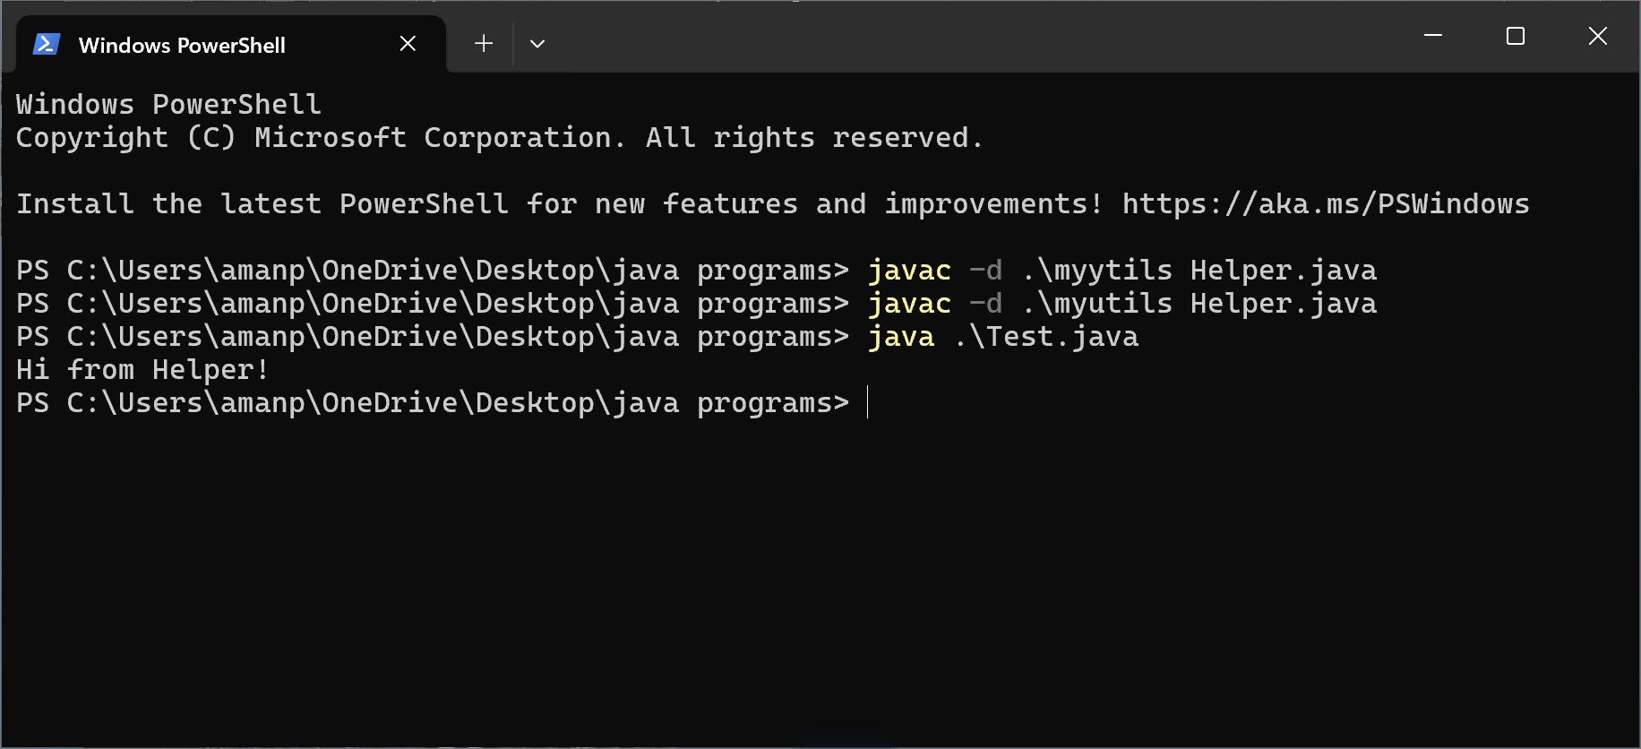
package myutils; public class Helper {
protected void sayHi() {
System.out.println("Hi from Helper!");
}
}

Slide 14
Public Access Modifier
The public access modifier is accessible everywhere. It has the widest scope among all other modifiers.
package myutils;
public class Helper {
public void sayHi() {
System.out.println("Hi from Helper!");
}
}

Slide 15
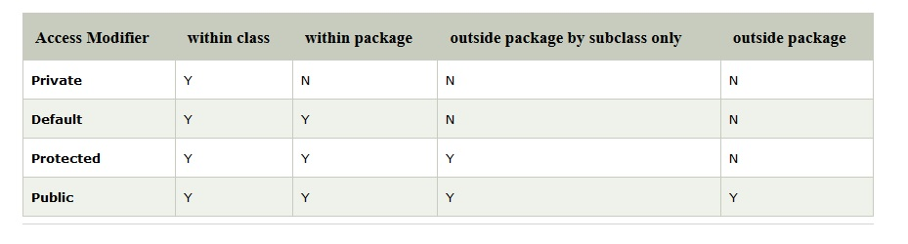
All Java Access Modifiers

Slide 16
Access Modifiers with Method Overriding
class A
{
protected void msg(){System.out.println("Hellojava");}
}
class B extends A
{
void msg() {System.out.println("Hellojava");} //C.T.Error
}
public class Test {
public static void main(String[] args) {
B obj=new B();
obj.msg();
}
}
// error: msg() in B cannot override msg() in A
If you are overriding any method, overridden method (i.e. declared in subclass) must not be more restrictive.
The default modifier is more restrictive than protected. That is why there is compile time error.

Slide 17
You cannot reduce the visibility of an overridden method from the superclass.“
visibility hierarchy:
private < default < protected < public

Slide 18
Correct method
class A
{
protected void msg(){System.out.println("Hellojava");}
}
class B extends A
{
public void msg() {System.out.println("Hellojava");}
// no C.T.Error
}
public class Test {
public static void main(String[] args) {
B obj=new B();
obj.msg();
}
}

